Slide 1
MARKETPLACE FOR NORTHWEST One place to buy and sell
Section - 03
Team - 03
Dr. Chandra Mouli Kotteti – Client/Mentor
Usha Pati – Quality Analyst
Kiran Kumar Gundapuneni – Backend Developer
Hari Kiran Aluri – Frontend Developer
Sajida Mohammad – Backend developer

Slide 2
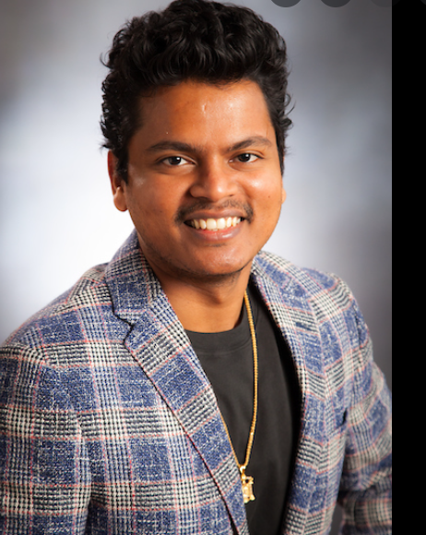
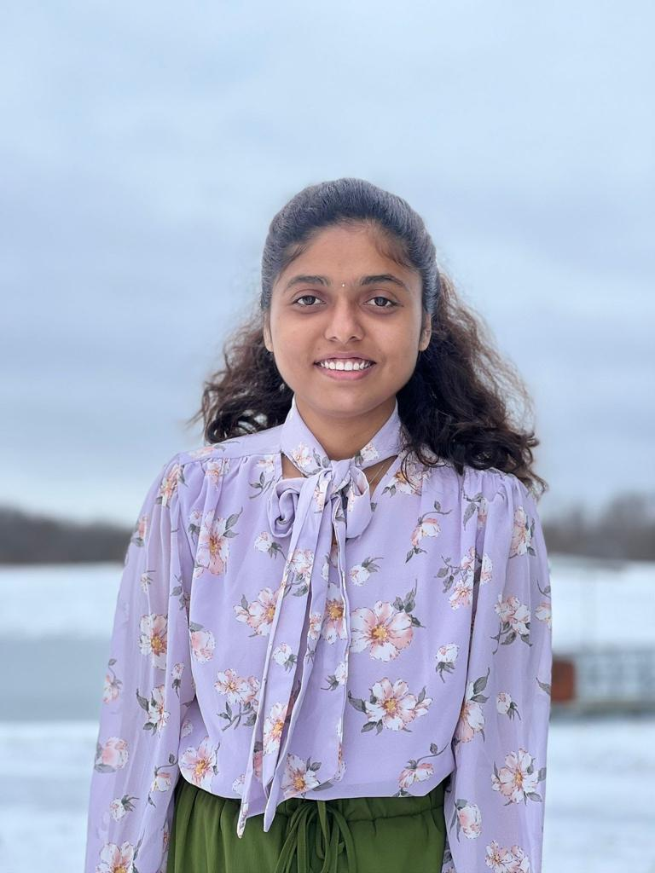
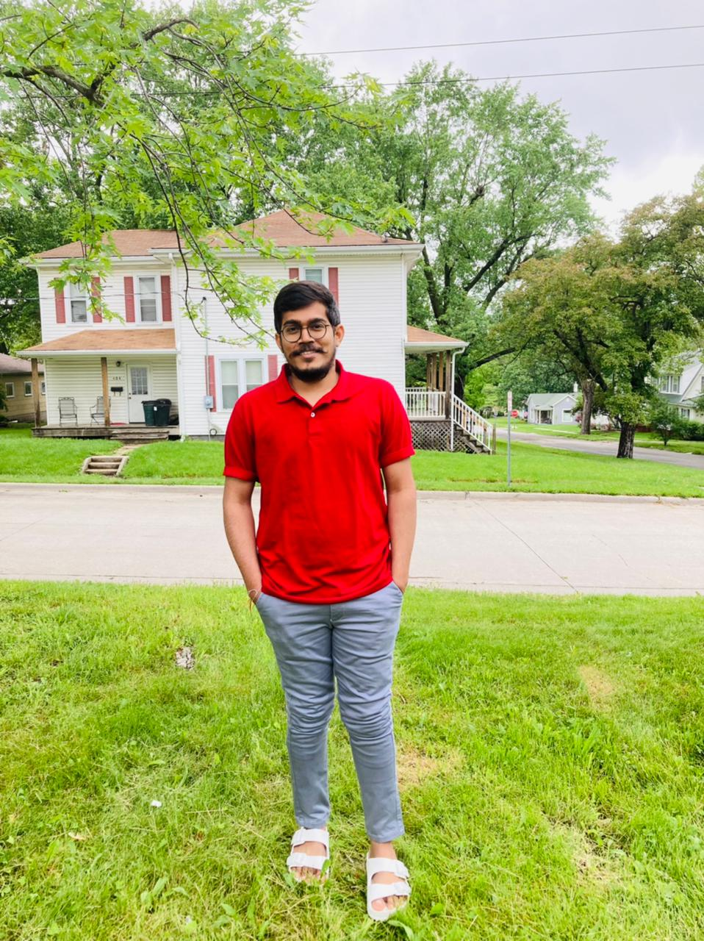

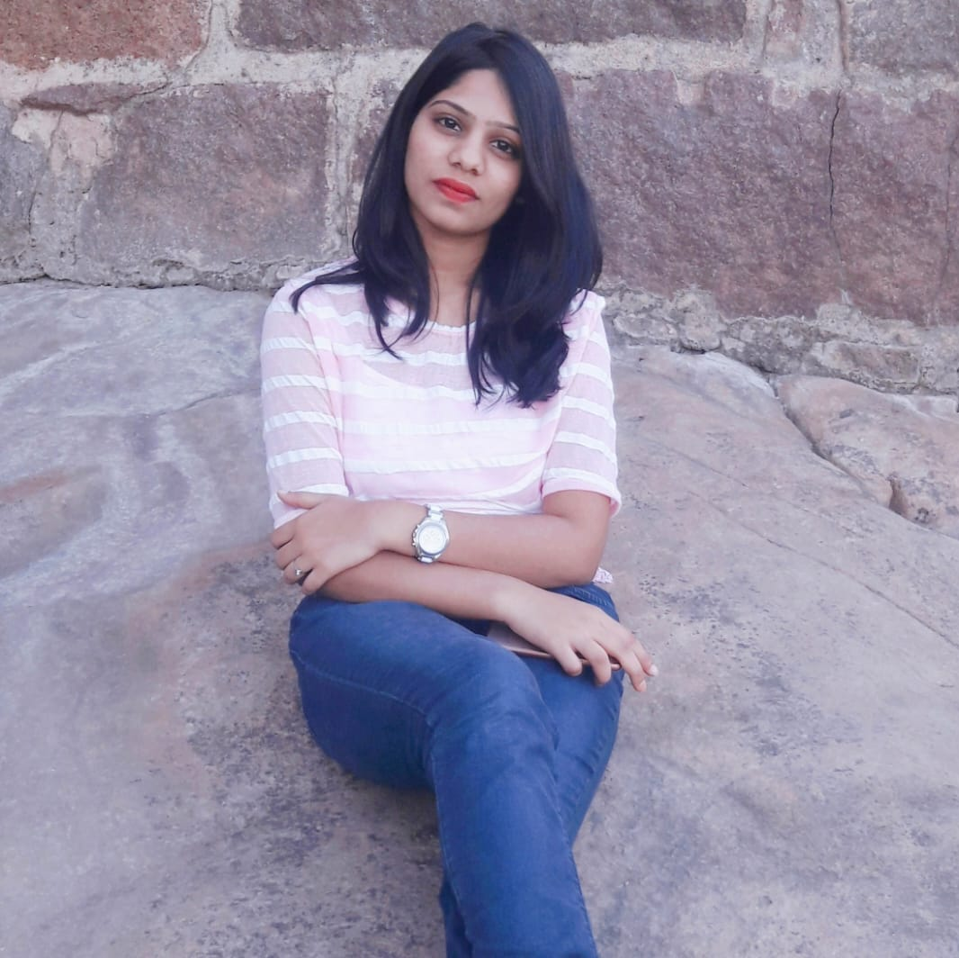
TEAM MEMBERS
USHA PATI
KIRANKUMAR GUNDAPUNENI
DR.CHANDRA MOULI
KOTTETI
HARI KIRAN ALURI
SAJIDA MOHAMMAD

Slide 3
TABLE OF CONTENTS
1
Sell functionality
Buy functionality
Ads functionality
Lessons learnt
Summary
References
USHA PATI

Slide 4
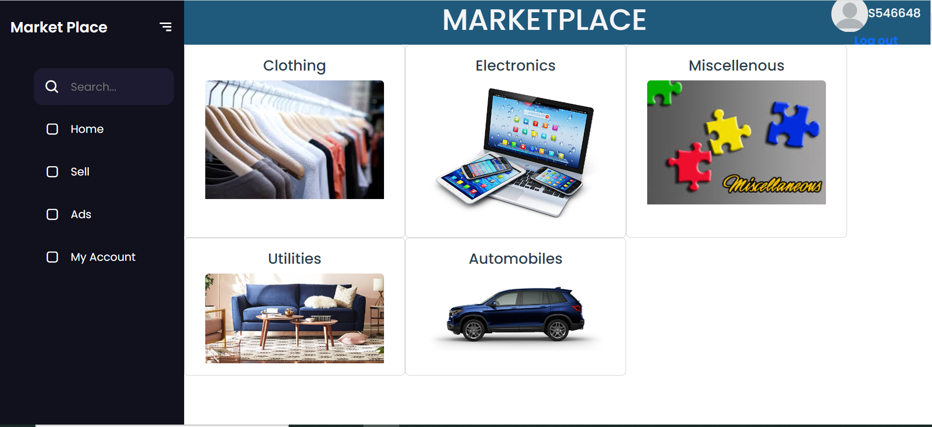
Home Page UI
2
Fig 1. Home Page UI
USHA PATI

Slide 5

Buy SEQUENCES
3
When user likes to buy a product, has to come to this screen and see the listings available and pick or browse on it
He/She will select the item from the list and visit the product for more details
He/She can reach the customer on the listed phone number and makes the deal
USHA PATI

Slide 6
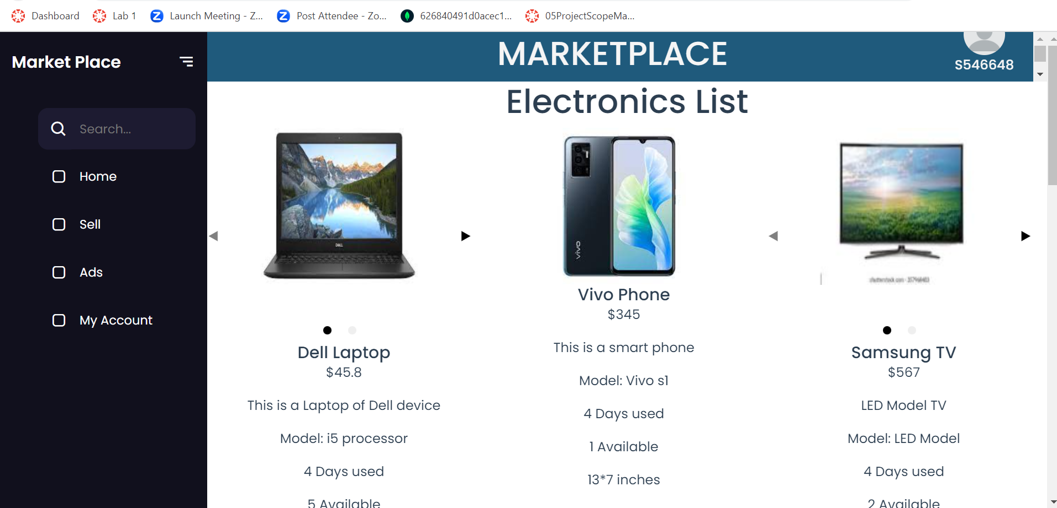
BUY FUNCTIONALITY UI
4
Fig 2. Buy Functionality UI
USHA PATI

Slide 7

SELL FUNCTIONALITY
5
In this functionality the logged-in user will upload the pictures and details of the product which the person is ready to sell
We have categorized them into 4 Major sectors
Automobile
Household
Furniture
Electronics
KIRAN KUMAR GUNDAPUNENI

Slide 8
SELL FLOW
6
The items which don’t fall in the above sectors will go under a new category called Miscellaneous
Any end user who feels that his item doesn’t suit in above can opt for miscellaneous
Each category has its own characteristics, and each page has its own attributes
KIRAN KUMAR GUNDAPUNENI

Slide 9
Highlights of sell tech stack
7
User can upload multiple images for the product he would like to sell
01
UI is responsive and supports various browser platforms
02
Details of each individual product are displayed under the image uploaded
03
KIRAN KUMAR GUNDAPUNENI

Slide 10
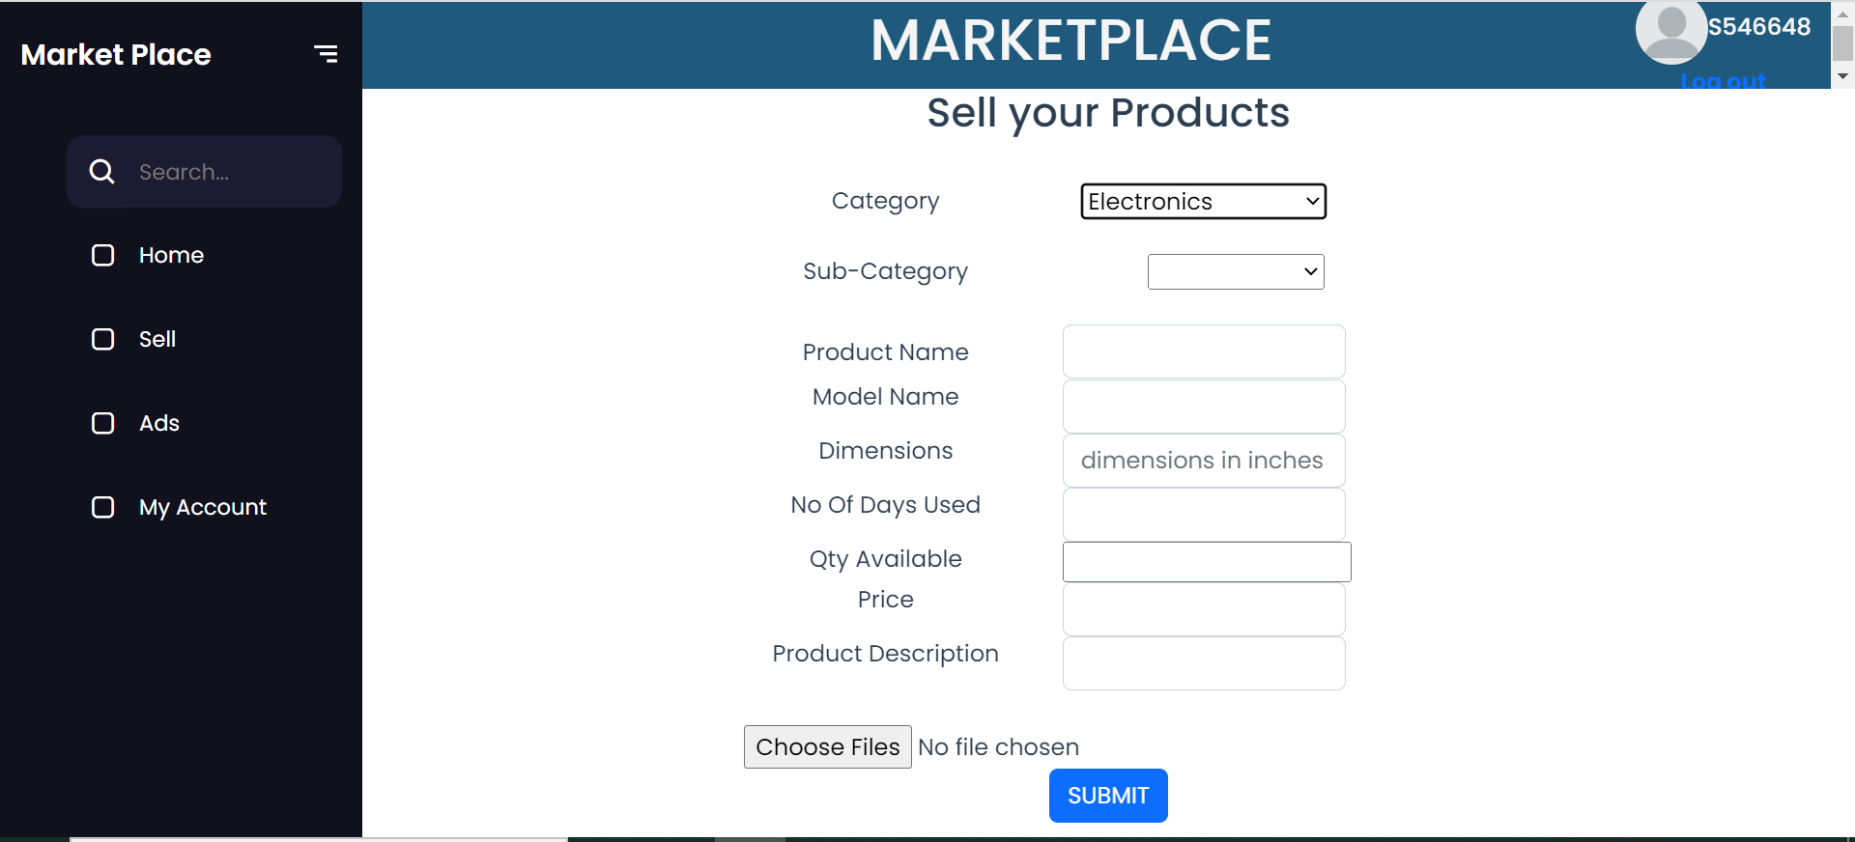
Sell Home Page
8
Fig 3. Sell Home Page UI
KIRAN KUMAR GUNDAPUNENI

Slide 11
ADS FUNCTIONALITY
9
This page is used to display the details of the product that the user has advertised till now in the Sell page
HARI KIRAN ALURI

Slide 12
Why ADS?
10
The two main uses of ADS functionality are
To update /delete the product details like color , price , description or to delete the entire product
To display all the details that the user has advertised till now on the selling page
HARI KIRAN ALURI

Slide 13
How DOES ADS Functionality work?
11
Once the user advertise his/her product based on the category
This function will get the product details based on the student id which is unique to all the Student
This fetching process will be done to all the products in all the categories
Once the fetching process is done all the products that have been fetched will be displayed on this page
Additionally, update /delete will also be displayed so that particular user can alter the day
HARI KIRAN ALURI

Slide 14
LESSONS LEARNT
12
Faced issues when uploading images in BLOB format​
Unable to fetch multiple images
Saving the images in S2 bucket and storing the links in the database
Faced issues in displaying multiple images using Carousel in Buy Functionality
Handling multiple images with the same file name
SAJIDA MOHAMMAD

Slide 15
SUMMARY
13
Major app functionalities like Sell and Buy
ADS functionality
Upcoming Functionalities
Deploying the application to server
Contacting the Seller
Updating and Deleting the product Information
SAJIDA MOHAMMAD

Slide 16
REFERENCES
14
GitHub : https://github.com/harichowdary-aluri/gdp_1-project
Thank you : https://tenor.com/view/thank-you-gif-25595761
Vue: https://vuejs.org/guide/essentials/application.html
Spring boot: https://docs.spring.io/spring-boot/docs/current/reference/html/
Any Questions : https://stock.adobe.com/search?k=%22any+questions%22&asset_id=421593489
SAJIDA MOHAMMAD

Slide 17


Slide 18


Slide 19
TEAM MEMBERS
KIRANKUMAR GUNDAPUNENI
DR.CHANDRA MOULI
KOTTETI
USHA PATI
HARI KIRAN ALURI
SAJIDA MOHAMMAD

Slide 20
MARKETPLACE FOR NORTHWEST One place to buy and sell
SECTION - 03
TEAM - 03
DR. CHANDRA MOULI KOTTETI – CLIENT/MENTOR
USHA PATI – TESTER/QA
KIRAN KUMAR GUNDAPUNENI – BACKEND DEVELOPER
HARI KIRAN ALURI – FRONT END DEVELOPER
SAJIDA MOHAMMAD – BACKEND DEVELOPER

